Slide 1


Exposure Java 2013
APCS Edition
Chapter 7 Slides
Creating Class Methods
PowerPoint Presentation
created by:
Mr. John L. M. Schram
and Mr. Leon Schram
Authors of Exposure Java

Slide 2
Section 7.1
Introduction

Slide 3

Primitive Data Types vs. Classes
A simple/primitive data type can store only one single value.
This means an int can only store one integer.
A double can only store one real number.
A char can only store one character.
On the other hand, a class is a complex data type. An object is a complex variable that can store multiple pieces of information (class attributes) as well as several methods (class actions).

Slide 4
“Mr. Schram, are object methods ‘void’ or ‘return’ methods?”
What you need to realize is that the whole class
method vs. object method thing has nothing
to do with the whole void method vs. return
method thing. Let us spell it out plainly:
1. A method can be BOTH a void method and a class method.
2. A method can be BOTH a void method and an object method.
3. A method can be BOTH a return method and a class method.
4. A method can be BOTH a return method and an object method.
So there are void class methods, void object methods, return class methods, and return object methods.

Slide 5
Section 7.2
The Math Class
Revisited

Slide 6
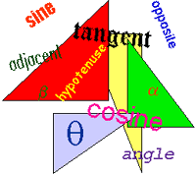
Additional Math Class Methods
Math.exp(p) returns the antilog of p, or e^{p}
Math.log(p) returns the log (base e) of p
Math.sin(p) returns the trigonometric sine of p
Math.cos(p) returns the trigonometric cosine of p
Math.tan(p) returns the trigonometric tangent of p
Math.toDegrees(p) returns the number of degrees in p radians
Math.toRadians(p) returns the number of radians in p degrees

Slide 7
// Java0701.java
// This program reviews using class methods and demonstrates most of the
// available <Math> class methods and data fields.
public class Java0701
{
public static void main (String args[])
{
System.out.println("\nJAVA0701.JAVA\n");
System.out.println("The value of E is " + Math.E);
System.out.println("The value of PI is " + Math.PI);
System.out.println("The absolute value of (-25) is " + Math.abs(-25));
System.out.println("The square root of (1024) is " + Math.sqrt(1024));
System.out.println("The ceiling of (5.00001) is " + Math.ceil(5.00001));
System.out.println("The floor of (5.99999) is " + Math.floor(5.99999));
System.out.println("The round of (5.50001) is " + Math.round(5.50001));
System.out.println("The antilog of (4.605170185) is " + Math.exp(4.605170185));
System.out.println("The log of (100) is " + Math.log(100));
System.out.println("The max of (1000,999) is " + Math.max(1000,999));
System.out.println("The min of (1000,999) is " + Math.min(1000,999));
System.out.println("The power of (4,3) is " + Math.pow(4,3));
System.out.println("The random of () is " + Math.random());
System.out.println("The sine of (0) is " + Math.sin(0));
System.out.println("The cosine of (3.141592653) is " + Math.cos(3.141592653));
System.out.println("The tangent of (0.785398163) is " + Math.tan(0.785398163));
System.out.println("The toDegrees of (3.141592653) is " + Math.toDegrees(3.141592653));
System.out.println("The toRadians of (180) is " + Math.toRadians(180));
System.out.println();
}
}

Slide 8
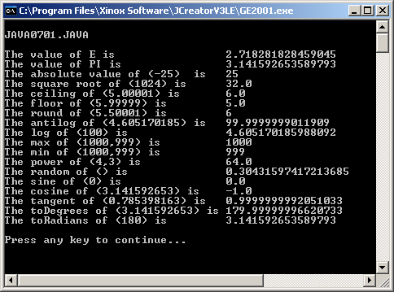

Slide 9
Section 7.3
Modular Programming &
User Created Methods

Slide 10
Modular Programming
Modular Programming is the process of placing statements that achieve a common purpose into its own module.
An old programming saying says it well:
One Task, One Module

Slide 11
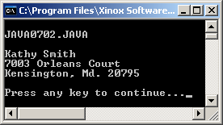
// Java0702.java
// This program displays a simple mailing address.
// It is used to demonstrate how to divide sections in
// the main method into multiple user-created methods.
public class Java0702
{
public static void main(String[] args)
{
System.out.println("\nJAVA0702.JAVA\n");
System.out.println("Kathy Smith");
System.out.println("7003 Orleans Court");
System.out.println("Kensington, Md. 20795");
System.out.println();
}
}

Slide 12
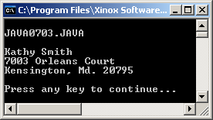
// Java0703.java
// This program introduces user-created class methods.
// The three class methods are called with the same dot.method syntax
// as the methods of the Math class.
public class Java0703
{
public static void main(String[] args)
{
System.out.println("\nJAVA0703.JAVA\n");
Java0703.fullName();
Java0703.street();
Java0703.cityStateZip();
System.out.println();
}
public static void fullName() { System.out.println("Kathy Smith"); }
public static void street() { System.out.println("7003 Orleans Court"); }
public static void cityStateZip() { System.out.println("Kensington, Md. 20795"); }
}

Slide 13
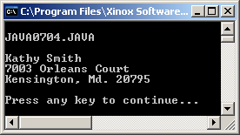
// Java0704.java
// This program example displays the same output as the previous program.
// This time the methods are called directly without using the class identifier.
// Omitting the class identifier is possible because all the methods are
// encapsulated in the same class, Java0704.
public class Java0704
{
public static void main(String[] args)
{
System.out.println("\nJAVA0704.JAVA\n");
fullName();
street();
cityStateZip();
System.out.println();
}
public static void fullName() { System.out.println("Kathy Smith"); }
public static void street() { System.out.println("7003 Orleans Court"); }
public static void cityStateZip() { System.out.println("Kensington, Md. 20795"); }
}

Slide 14
Using the Class Identifier
The name of the class is called the class identifier.
Using the class identifier is optional if you are calling a method that is in the same class.
Using the class identifier is required if you are calling a method that is in a different class.

Slide 15
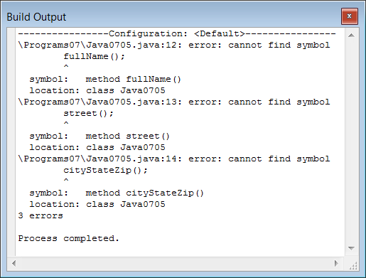
// Java0705.java
// This program demonstrates how to use a second class separate from the
// main program class. This program will not compile because the Name,
// Street and CityStateZip methods are no longer encapsulated in Java0705.
public class Java0705
{
public static void main(String args[])
{
System.out.println("\nJAVA0705.JAVA\n");
fullName();
street();
cityStateZip();
System.out.println();
}
}
class Address
{
public static void fullName() { System.out.println("Kathy Smith"); }
public static void street() { System.out.println("7003 Orleans Court"); }
public static void cityStateZip() { System.out.println("Kensington, Md. 20795"); }
}

Slide 16

// Java0706.java
// The problem of Java0705.java is now fixed. It is possible to declare
// multiple classes in one program. However, you must use the dot.method
// syntax to call any of the <Address> class methods.
public class Java0706
{
public static void main(String args[])
{
System.out.println("\nJAVA0706.JAVA\n");
Address.fullName();
Address.street();
Address.cityStateZip();
System.out.println();
}
}
class Address
{
public static void fullName() { System.out.println("Kathy Smith"); }
public static void street() { System.out.println("7003 Orleans Court"); }
public static void cityStateZip() { System.out.println("Kensington, Md. 20795"); }
}

Slide 17
// Java0706.java
// The problem of Java0705.java is now fixed. It is possible to declare
// multiple classes in one program. However, you must use the dot.method
// syntax to call any of the <Address> class methods.
public class Java0706
{
public static void main(String args[])
{
System.out.println("\nJAVA0706.JAVA\n");
Address.fullName();
Address.street();
Address.cityStateZip();
System.out.println();
}
}
class Address
{
public static void fullName() { System.out.println("Kathy Smith"); }
public static void street() { System.out.println("7003 Orleans Court"); }
public static void cityStateZip() { System.out.println("Kensington, Md. 20795"); }
}
NOTE:
The 2nd class does NOT
use the keyword public.
Only the class with the same name as the file uses public.

Slide 18
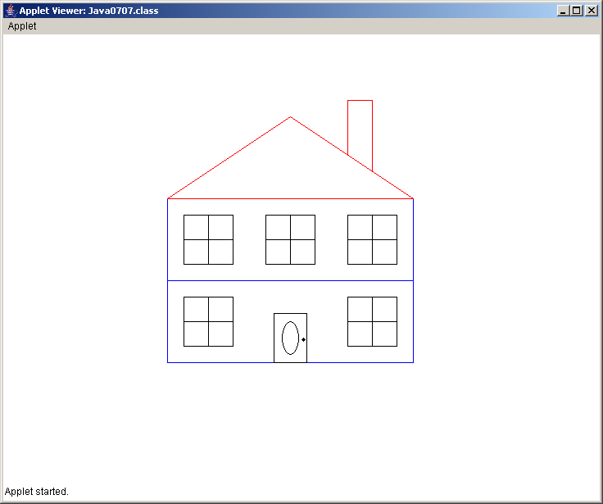
// Java0707.java
// This program draws a house by placing all the necessary program statements in the <paint> method.
import java.awt.*;
import java.applet.*;
public class Java0707 extends Applet
{
public void paint(Graphics g)
{
Expo.setColor(g,Expo.blue);
Expo.drawRectangle(g,200,200,500,300);
Expo.drawRectangle(g,200,300,500,400);
Expo.setColor(g,Expo.red);
Expo.drawLine(g,200,200,350,100);
Expo.drawLine(g,500,200,350,100);
Expo.drawLine(g,200,200,500,200);
Expo.setColor(g,Expo.red);
Expo.drawLine(g,420,146,420,80);
Expo.drawLine(g,420,80,450,80);
Expo.drawLine(g,450,80,450,166);
Expo.setColor(g,Expo.black);
Expo.drawRectangle(g,330,340,370,400);
Expo.drawOval(g,350,370,10,20);
Expo.fillCircle(g,366,370,3);
Expo.setColor(g,Expo.black);
Expo.drawRectangle(g,220,220,280,280);
Expo.drawLine(g,220,250,280,250);
Expo.drawLine(g,250,220,250,280);
Expo.drawRectangle(g,420,220,480,280);
Expo.drawLine(g,420,250,480,250);
Expo.drawLine(g,450,220,450,280);
Expo.drawRectangle(g,320,220,380,280);
Expo.drawLine(g,320,250,380,250);
Expo.drawLine(g,350,220,350,280);
Expo.drawRectangle(g,220,320,280,380);
Expo.drawLine(g,220,350,280,350);
Expo.drawLine(g,250,320,250,380);
Expo.drawRectangle(g,420,320,480,380);
Expo.drawLine(g,420,350,480,350);
Expo.drawLine(g,450,320,450,380);
}
}
NOTE:
This is NOT Good Program Design.
If you wanted to change the appearance of the door or a window, you would have to figure out which part of the program to edit.

Slide 19
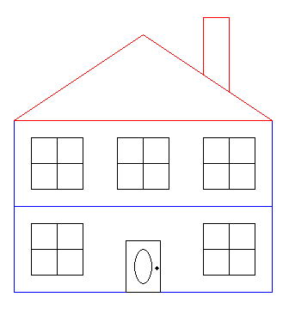
// Java0708.java
// This program divides all the statements of <paint> in the previous program into 5 separate methods
import java.awt.*; import java.applet.*; public class Java0708 extends Applet { public void paint(Graphics g) { drawFloors(g); drawRoof(g); drawChimney(g); drawDoor(g); drawWindows(g); } public static void drawFloors(Graphics g) { g.setColor(Color.blue); g.drawRect(200,200,300,100); g.drawRect(200,300,300,100); } public static void drawRoof(Graphics g) { g.setColor(Color.red); g.drawLine(200,200,350,100); g.drawLine(500,200,350,100); g.drawLine(200,200,500,200); } | public static void drawChimney(Graphics g) { g.setColor(Color.red); g.drawLine(420,146,420,80); g.drawLine(420,80,450,80); g.drawLine(450,80,450,166); } public static void drawDoor(Graphics g) { g.setColor(Color.black); g.drawRect(330,340,40,60); g.drawOval(340,350,20,40); g.fillOval(364,370,5,5); } public static void drawWindows(Graphics g) { g.setColor(Color.black); g.drawRect(220,220,60,60); g.drawLine(220,250,280,250); g.drawLine(250,220,250,280); g.drawRect(420,220,60,60); g.drawLine(420,250,480,250); g.drawLine(450,220,450,280); g.drawRect(320,220,60,60); g.drawLine(320,250,380,250); g.drawLine(350,220,350,280); g.drawRect(220,320,60,60); g.drawLine(220,350,280,350); g.drawLine(250,320,250,380); g.drawRect(420,320,60,60); g.drawLine(420,350,480,350); g.drawLine(450,320,450,380); } }

Slide 20
// Java0709.java This program uses the better program design of creating a separate <House> class,
// which contains the five methods to draw the complete hour program.
import java.awt.*; import java.applet.*; public class Java0709 extends Applet { public void paint(Graphics g) { House.drawFloors(g); House.drawRoof(g); House.drawChimney(g); House.drawDoor(g); House.drawWindows(g); } } class House { public static void drawFloors(Graphics g) { g.setColor(Color.blue); g.drawRect(200,200,300,100); g.drawRect(200,300,300,100); } public static void drawRoof(Graphics g) { g.setColor(Color.red); g.drawLine(200,200,350,100); g.drawLine(500,200,350,100); g.drawLine(200,200,500,200); } | public static void drawChimney(Graphics g) { g.setColor(Color.red); g.drawLine(420,146,420,80); g.drawLine(420,80,450,80); g.drawLine(450,80,450,166); } public static void drawDoor(Graphics g) { g.setColor(Color.black); g.drawRect(330,340,40,60); g.drawOval(340,350,20,40); g.fillOval(364,370,5,5); } public static void drawWindows(Graphics g) { g.setColor(Color.black); g.drawRect(220,220,60,60); g.drawLine(220,250,280,250); g.drawLine(250,220,250,280); g.drawRect(420,220,60,60); g.drawLine(420,250,480,250); g.drawLine(450,220,450,280); g.drawRect(320,220,60,60); g.drawLine(320,250,380,250); g.drawLine(350,220,350,280); g.drawRect(220,320,60,60); g.drawLine(220,350,280,350); g.drawLine(250,320,250,380); g.drawRect(420,320,60,60); g.drawLine(420,350,480,350); g.drawLine(450,320,450,380); } }

Slide 21
Some Program Design Notes
Programs should not be written by placing all the program statements in the main or paint methods.
Program statements that perform a specific purpose should be placed inside their own modules. This follows the one-task, one-module principle of earlier program design principles.
Object Oriented Design continues by placing modules of a common nature into a separate class.
In this chapter you are learning how to create class methods.
The distinction between creating class methods and object methods will become clear in the next chapter.

Slide 22
Section 7.4
User - Declared
Parameter Methods

Slide 23
Method Calls With & Without Parameters
Parameter method example:
double result1 = Math.sqrt(100);
double result2 = Math.pow(2,5);
Non-Parameter method examples:
Bug barry = new Bug();
barry.move();
barry.turn();
Overloaded method examples:
System.out.println("Hello World");
System.out.println();

Slide 24
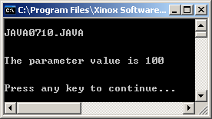
// Java0710.java
// This program introduces user-defined methods with parameters.
// The purpose of using parameters may be hard to tell, but at this
// stage concentrate on the mechanics and the manner in which information
// is passed from one program module to another program module.
public class Java0710
{
public static void main(String args[])
{
System.out.println("\nJAVA0710.JAVA\n");
displayParameter(100);
System.out.println();
}
public static void displayParameter(int number)
{
System.out.println();
System.out.println("The parameter value is " + number);
System.out.println();
}
}

Slide 25
Parameters Terminology
Actual Parameters
The parameters in the method call.
This is the actual information that you are sending to the method.
Formal Parameters
The parameters in the method heading.
This is the formal declaration of the parameters. Here their form is determined.
displayParameter(100);
public static void displayParameter(int number)

Slide 26
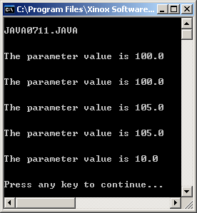
// Java0711.java
// This program demonstrates that the calling parameter can be:
// a constant, like 100; a variable, like value;
// an expression with only constants, like 10 + 5;
// an expression with a variable and a constant like value + 5.
// A call to a method, which returns a value, like Math.sqrt(100).
public class Java0711
{
public static void main(String args[])
{
System.out.println("\nJAVA0711.JAVA\n");
double value = 100;
displayParameter(100);
displayParameter(value);
displayParameter(100 + 5);
displayParameter(value + 5);
displayParameter(Math.sqrt(100));
System.out.println();
}
public static void displayParameter(double number)
{
System.out.println();
System.out.println("The parameter value is " + number);
}
}

Slide 27
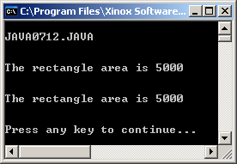
// Java0712.java
// This program demonstrates passing two parameters to a method.
// The <showArea> method is called twice. In this case reversing
// the sequence of the parameters is not a problem.
public class Java0712
{
public static void main(String args[])
{
System.out.println("\nJAVA0712.JAVA\n");
int width = 100;
int height = 50;
showArea(width, height);
showArea(height, width);
System.out.println();
}
public static void showArea(int w, int h )
{
System.out.println();
int area = w * h;
System.out.println("The rectangle area is " + area);
System.out.println();
}
}

Slide 28
The Football Analogy
The Quarterback - The Actual Parameters
The Football - A copy of the data
The actual parameters pass the data to the formal parameters.
The Receiver - Formal Parameters
showArea(length, width);
showArea
100, 50
public static void showArea(int L, int W )

Slide 29
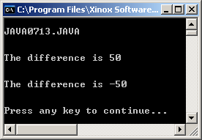
// Java0713.java
// This program demonstrates that parameter sequence matters.
// In this example method <showDifference> will display different
// results when the calling parameters are reversed.
public class Java0713
{
public static void main(String args[])
{
System.out.println("\nJAVA0713.JAVA\n");
int num1 = 100;
int num2 = 50;
showDifference(num1, num2);
showDifference(num2, num1);
System.out.println();
}
public static void showDifference(int a, int b)
{
System.out.println();
int difference = a - b;
System.out.println("The difference is " + difference);
System.out.println();
}
}
Parameter
sequence is
important!

Slide 30
Actual Parameter Sequence Matters
The first actual parameter passes information to the first formal parameter.
The second actual parameter passes information to the second formal parameter.
Parameters placed out of sequence may result in compile errors or logic errors.

Slide 31
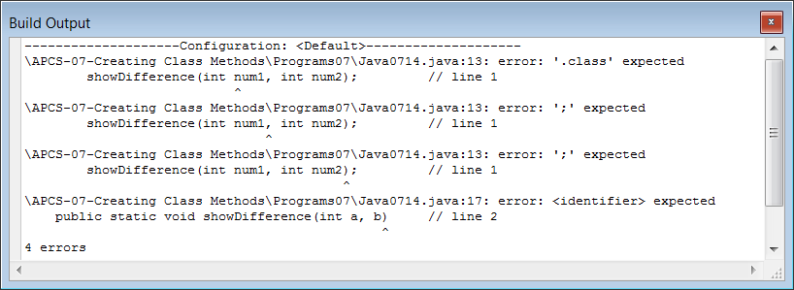
// Java0714.java
// This program demonstrates a common mistake made by students.
// Parameters are declared in the method heading, but may not be
// declared in the method call. This program will not compile.
public class Java0714
{
public static void main(String args[])
{
System.out.println("\nJAVA0714.JAVA\n");
showDifference(int num1, int num2); // line 1
System.out.println();
}
public static void showDifference(int a, b) // line 2
{
System.out.println();
int difference = a - b;
System.out.println("The difference is " + difference);
System.out.println();
}
}

Slide 32
Common Parameters Mistakes
Wrong | Correct
qwerty(int num1, int num2); | int num1 = 100; int num2 = 200; qwerty(num1,num2);
public static void qwerty(int a, b); | public static void qwerty(int a, int b)

Slide 33
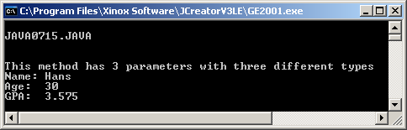
// Java0715.java
// This program demonstrates that multiple parameters may be different data types.
public class Java0715
{
public static void main(String args[])
{
System.out.println("\nJAVA0715.JAVA\n");
// 3 different type parameters method call
multiTypeDemo("Hans", 30, 3.575);
System.out.println();
}
public static void multiTypeDemo(String studentName, int studentAge, double studentGPA)
{
System.out.println("\nThis method has 3 parameters with three different types");
System.out.println("Name: " + studentName);
System.out.println("Age: " + studentAge);
System.out.println("GPA: " + studentGPA);
}
}

Slide 34
Parameter Rules
The parameters in the method call and the method heading must match three ways:
1. They must be the same quantity
2. They must be the same type
3. They must be the same sequence

Slide 35


The Track Relay Analogy – Race 1
US | US
GB | GB
FR | FR
NL
The second runner from the Netherlands is missing.
The number of actual parameters and formal parameters do not match.

Slide 36
The Track Relay Analogy – Race 2
US | US
GB | GB
FR | NL
NL | FR
The second runners from the Netherlands and France are in the wrong lane.
The formal parameters are not in the same order as the actual parameters. They must correspond.

Slide 37

The Track Relay Analogy – Race 3
US (John) | US (Greg)
GB (Charles) | GB (William)
FR (Gerald) | FR (Louis)
NL (Hans) | NL (Hans)
The runners are in proper staring position.
The parameters correspond.
The fact that there are 2 people from the Netherlands
with the same name is not a problem.

Slide 38
Important Rules About Using Parameters with Methods
The number of parameters in the method call (actual parameters) must match the number of parameters in the method heading (formal parameters).
The corresponding actual parameters must be the same type as the formal parameters.
The sequence of the actual parameters must match the sequence of the formal parameters.
The actual parameter identifiers may be the same identifier or a different identifier as the formal parameters.

Slide 39
Section 7.5
void Methods &
return Methods

Slide 40
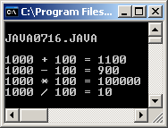
// Java0716.java This program demonstrates how to use the <Calc> class with void methods.
public class Java0716 { public static void main(String args[]) { System.out.println( "\nJAVA0716.JAVA\n"); int number1 = 1000; int number2 = 100; Calc.add(number1,number2); Calc.sub(number1,number2); Calc.mul(number1,number2); Calc.div(number1,number2); System.out.println(); } } | class Calc { public static void add(int n1, int n2) { int result = n1 + n2; System.out.println(n1 + " + " + n2 + " = " + result); } public static void sub(int n1, int n2) { int result = n1 - n2; System.out.println(n1 + " - " + n2 + " = " + result); } public static void mul(int n1, int n2) { int result = n1 * n2; System.out.println(n1 + " * " + n2 + " = " + result); } public static void div(int n1, int n2) { int result = n1 / n2; System.out.println(n1 + " / " + n2 + " = " + result); } }

Slide 41
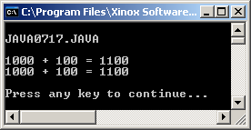

// Java0717.java
// This program demonstrates the difference between a
// void <Sum1> method and a return <Sum2> method.
// There are two differences:
// void and return methods are declared differently.
// void and return methods are also called differently.
public class Java0717
{
public static void main(String args[])
{
System.out.println("\nJAVA0717.JAVA\n");
int nbr1 = 1000;
int nbr2 = 100;
sum1(nbr1,nbr2);
System.out.println(nbr1 + " + " + nbr2 + " = " + sum2(nbr1,nbr2));
System.out.println();
}
public static void sum1(int n1, int n2)
{
int sum = n1 + n2;
System.out.println(n1 + " + " + n2 + " = " + sum);
}
public static int sum2(int n1, int n2)
{
int sum = n1 + n2;
return sum;
}
}

Slide 42
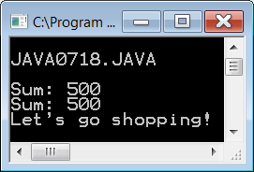
// Java0718.java
// This program reviews different ways to call a return method.
public class Java0718
{
public static void main(String args[])
{
System.out.println("\nJAVA0718.JAVA\n");
System.out.println("Sum: " + sum(200,300));
int sum = sum(200,300);
System.out.println("Sum: " + sum);
int checking = 200;
int savings = 300;
if (sum(checking,savings) <= 0)
System.out.println("You are broke!");
else
System.out.println("Let's go shopping!");
System.out.println();
}
public static int sum(int n1, int n2)
{
int sum = n1 + n2;
return sum;
}
}

Slide 43
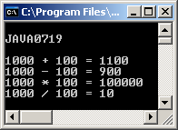
// Java0719.java
// This program demonstrates how to create a four-function <Calc> class
// with return methods.
public class Java0719
{
public static void main(String args[])
{
System.out.println("\nJAVA0719n");
int nbr1 = 1000;
int nbr2 = 100;
System.out.println(nbr1 + " + " + nbr2 + " = " + Calc.add(nbr1,nbr2));
System.out.println(nbr1 + " - " + nbr2 + " = " + Calc.sub(nbr1,nbr2));
System.out.println(nbr1 + " * " + nbr2 + " = " + Calc.mul(nbr1,nbr2));
System.out.println(nbr1 + " / " + nbr2 + " = " + Calc.div(nbr1,nbr2));
System.out.println();
}
}
class Calc
{
public static int add(int n1, int n2) { return n1 + n2; }
public static int sub(int n1, int n2) { return n1 - n2; }
public static int mul(int n1, int n2) { return n1 * n2; }
public static int div(int n1, int n2) { return n1 / n2; }
}

Slide 44
Section 7.6
Making a
Utility Library

Slide 45
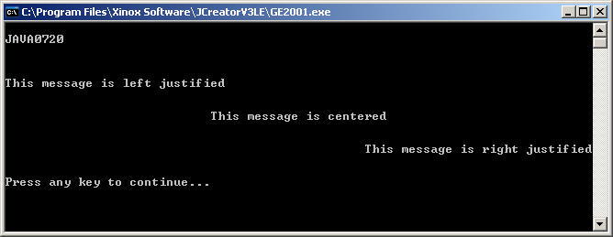
// Java0720.java This program demonstrates a user-declared <Util> with
// a variety of methods that can be used in any program.
public class Java0720 { public static void main(String args[]) { System.out.println("\nJAVA0711n"); Util.skip(2); System.out.println("This message is left justified"); Util.skip(2); Util.center("This message is centered"); Util.skip(2); Util.rightJustify("This message is right justified"); Util.skip(1); } } | class Util { public static void skip(int n) { for (int k = 1; k <= n; k++) System.out.println(); } public static void center(String str) { int len = str.length(); int tab = (80 - len) / 2; for (int k = 1; k <= tab; k++) System.out.print(" "); System.out.println(str); } public static void rightJustify(String str) { int len = str.length(); int tab = 80 - len; for (int k = 1; k <= tab; k++) System.out.print(" "); System.out.println(str); } }

Slide 46
// Java0721.java This program adds the <heading> method to the <Util> class.
public class Java0721 { public static void main(String args[]) { Util.heading("Leon Schram","Java0721.java", "10-24-06","100 Points"); System.out.println("This message is left justified"); Util.skip(2); Util.center("This message is centered"); Util.skip(2); Util.rightJustify("This message is right justified"); Util.skip(1); } } class Util { public static void skip(int n) { for (int k = 1; k <= n; k++) System.out.println(); | public static void center(String str) { int len = str.length(); int tab = (80 - len) / 2; for (int k = 1; k <= tab; k++) System.out.print(" "); System.out.println(str); } public static void rightJustify(String str) { int len = str.length(); int tab = 80 - len; for (int k = 1; k <= tab; k++) System.out.print(" "); System.out.println(str); } public static String spaces(int n) { String temp = ""; for (int k = 1; k <= n; k++) temp += " "; return temp; }
heading method on next slide
spaces is a helper method which is called by heading

Slide 47
// Java0721.java continued heading method of the Util class
public static void heading(String name, String lab, String date, String points)
{
int nameTab = 28 - name.length();
int labTab = 28 - lab.length();
int dateTab = 28 - date.length();
int pointsTab = 28 - points.length();
Util.skip(2);
System.out.println("****************************************************");
System.out.println("****************************************************");
System.out.println("** **");
System.out.println("** Student Name: " + name + spaces(nameTab) + "**");
System.out.println("** **"); System.out.println("** Lab Assignment: " + lab + spaces(labTab) + "**");
System.out.println("** **"); System.out.println("** Date Due: " + date + spaces(dateTab) + "**");
System.out.println("** **"); System.out.println("** Point Version: " + points + spaces(pointsTab) + "**");
System.out.println("** **"); System.out.println("****************************************************");
System.out.println("****************************************************");
Util.skip(2);
}
}

Slide 48
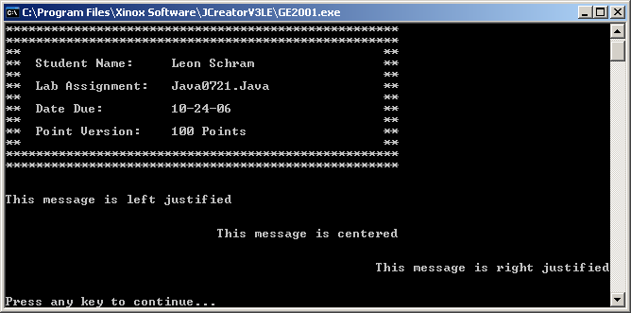
Output for
Program
Java0721.java

Slide 49
// Java0722.java
// This program is identical to Java0721.java with the <Util> class
// not included in this file.
public class Java0722
{
public static void main(String args[])
{
Util.heading("Leon Schram", "Lab0722", "10-24-06", "100 Points");
System.out.println("This message is left justified");
Util.skip(2);
Util.center("This message is centered");
Util.skip(2);
Util.rightJustify("This message is right justified");
Util.skip(1);
}
}

Slide 50
// Util.java
// This file is the <Util> class. This file can compile by itself, but it cannot execute.
// It requires the Java0722.java driver program to test the <Util> class.
class Util { public static void skip(int n) { for (int k = 1; k <= n; k++) System.out.println(); } public static void center(String str) { int len = str.length(); int tab = (80 - len) / 2; for (int k = 1; k <= tab; k++) System.out.print(" "); System.out.println(str); } public static void rightJustify(String str) { int len = str.length(); int tab = 80 - len; for (int k = 1; k <= tab; k++) System.out.print(" "); System.out.println(str); } public static String spaces(int n) { String temp = ""; for (int k = 1; k <= n; k++) temp += " "; return temp; } | public static void heading(String name, String lab, String date, String points) { int nameTab = 28 - name.length(); int labTab = 28 - lab.length(); int dateTab = 28 - date.length(); int pointsTab = 28 - points.length(); Util.skip(2); System.out.println("****************************************************"); System.out.println("****************************************************"); System.out.println("** **"); System.out.println("** Student Name: " + name + spaces(nameTab) + "**"); System.out.println("** **"); System.out.println("** Lab Assignment: " + lab + spaces(labTab) + "**"); System.out.println("** **"); System.out.println("** Date Due: " + date + spaces(dateTab) + "**"); System.out.println("** **"); System.out.println("** Point Version: " + points + spaces(pointsTab) + "**"); System.out.println("** **"); System.out.println("****************************************************"); System.out.println("****************************************************"); Util.skip(2); } }

Slide 51
3 Steps of Java Compiling
When the compiler encounters a statement like Util.skip(3) it needs to find the skip method
in the Util class. It will look in 3 spaces:
1. It will look for a Util class in the file you are compiling.
2. It will look for a file called Util.class
in the folder as the file you are compiling.
3. It will look for a file called Util.java
in that same folder, and then compile it into Util.class
This is why the file name must match the class name!

Slide 52
Section 7.7
The Payroll
Case Study

Slide 53
The Payroll Case Study
You are about to study eight stages of a case study.
This is the first of many case studies that will appear in your textbook.
The first program will be very simplistic and each program will make some small change or add something new.

Slide 54
// Java0723.java
// Payroll Case Study #1
// The first stage of the Payroll program has correct syntax and logic.
// However, there is no concern about any type of proper program design,
// even to the degree that there is no program indentation.
// This program is totally unreadable.
import java.util.Scanner;import java.text.*; public class Java0723 { public static void main (String args[]) { Scanner keyboard = new Scanner(System.in); String a; double b,c,e,f,g,h,i,j,k; int d; DecimalFormat output = new DecimalFormat("$0.00"); System.out.println("\nPAYROLL CASE STUDY #1\n"); System.out.print("Enter Name ===>> "); a = keyboard.nextLine(); System.out.print("Enter Hours Worked ===>> "); b = keyboard.nextDouble(); System.out.print("Enter Hourly Rate ===>> "); c = keyboard.nextDouble(); System.out.print ("Enter Dependents ===>> "); d = keyboard.nextInt(); if (b > 40) { e = b - 40; k = 40 * c; j = e * c * 1.5; } else { k = b * c; j = 0; } g = k + j; switch (d) { case 0 : f = 0.295; break; case 1 : f = 0.249; break; case 2 : f = 0.187; break; case 3 : f = 0.155; break; case 4 : f = 0.126; break; case 5 : f = 0.100; break; default: f = 0.075; } i = g * f; h = g - i; System.out.println("\n\n"); System.out.println("Name: " + a); System.out.println("Hourly rate: " + output.format(c)); System.out.println("Hours worked: " + b);System.out.println("Dependants: " + d); System.out.println("Tax rate: " + output.format(f)); System.out.println("Regular pay: " + output.format(k)); System.out.println("Overtime pay: " + output.format(j)); System.out.println("Gross pay: " + output.format(g)); System.out.println("Deductions: " + output.format(i)); System.out.println("Net pay: " + output.format(h)); System.out.println("\n\n"); } }

Slide 55
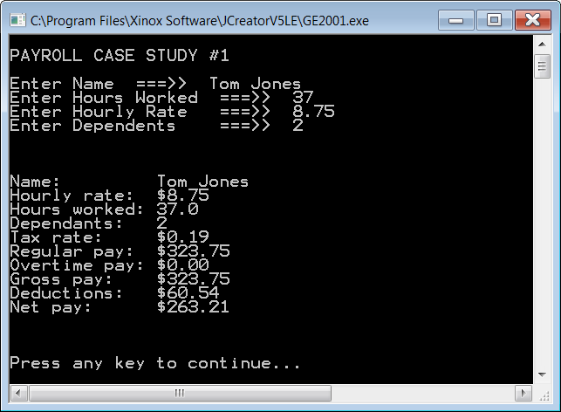
Output for Programs
Java0723.java
through
Java0727.java

Slide 56
// Java0724.java
// Payroll Case Study #2
// The second stage does use indentation, but it is still very poor program design.
// All the program logic is contained in the <main> method and there are no program
// comments anywhere, nor are the identifiers self-commenting.
import java.io.*;
import java.text.*;
public class Java0724
{
public static void main (String args[])
{
Scanner keyboard = new Scanner(System.in);
String a;
double b,c,e,f,g,h,i,j,k;
int d;
DecimalFormat output = new DecimalFormat("$0.00");
System.out.println("\nPAYROLL CASE STUDY #2\n");
System.out.print("Enter Name ===>> ");
a = keyboard.nextLine();
System.out.print("Enter Hours Worked ===>> ");
b = keyboard.nextDouble();
System.out.print("Enter Hourly Rate ===>> ");
c = keyboard.nextDouble();
System.out.print("Enter Dependents ===>> ");
d = keyboard.nextInt();
Continued on
the next few slides.

Slide 57
if (b > 40)
{
e = b - 40;
k = 40 * c;
j = e * c * 1.5;
}
else
{
k = b * c;
j = 0;
}
g = k + j;
switch (d)
{
case 0 : f = 0.295; break;
case 1 : f = 0.249; break;
case 2 : f = 0.187; break;
case 3 : f = 0.155; break;
case 4 : f = 0.126; break;
case 5 : f = 0.100; break;
default: f = 0.075;
}

Slide 58
i = g * f;
h = g - i;
System.out.println("\n\n");
System.out.println("Name: " + a);
System.out.println("Hourly rate: " + output.format(c));
System.out.println("Hours worked: " + b);
System.out.println("Dependants: " + d);
System.out.println("Tax rate: " + output.format(f));
System.out.println("Regular pay: " + output.format(k));
System.out.println("Overtime pay: " + output.format(j));
System.out.println("Gross pay: " + output.format(g));
System.out.println("Deductions: " + output.format(i));
System.out.println("Net pay: " + output.format(h));
System.out.println("\n\n");
}
}

Slide 59
// Java0725.java
// Payroll Case Study #3
// Stage 3 improves program readability by using meaningful identifiers.
import java.io.*;
import java.text.*;
public class Java0725
{
public static void main (String args[])
{
Scanner keyboard = new Scanner(System.in);
String employeeName;
double hoursWorked;
double hourlyRate;
int numDependants;
double overtimeHours;
double regularPay;
double overtimePay;
double taxRate;
double grossPay;
double taxDeductions;
double netPay;
DecimalFormat output = new DecimalFormat("$0.00");
Continued on
the next few slides.

Slide 60
System.out.println("\nPAYROLL CASE STUDY #3\n");
System.out.print("Enter Name ===>> ");
employeeName = keyboard.nextLine();
System.out.print("Enter Hours Worked ===>> ");
hoursWorked = keyboard.nextDouble();
System.out.print("Enter Hourly Rate ===>> ");
hourlyRate = keyboard.nextDouble();
System.out.print("Enter Deductions ===>> ");
numDependants = keyboard.nextInt();
if (hoursWorked > 40)
{
overtimeHours = hoursWorked - 40;
regularPay = 40 * hourlyRate;
overtimePay = overtimeHours * hourlyRate * 1.5;
}
else
{
regularPay = hoursWorked * hourlyRate;
overtimePay = 0;
}
grossPay = regularPay + overtimePay;

Slide 61
switch (numDependants)
{
case 0 : taxRate = 0.295; break;
case 1 : taxRate = 0.249; break;
case 2 : taxRate = 0.187; break;
case 3 : taxRate = 0.155; break;
case 4 : taxRate = 0.126; break;
case 5 : taxRate = 0.100; break;
default: taxRate = 0.075;
}
taxDeductions = grossPay * taxRate;
netPay = grossPay - taxDeductions;
System.out.println("\n\n");
System.out.println("Name: " + employeeName);
System.out.println("Hourly rate: " + output.format(hourlyRate));
System.out.println("Hours worked: " + hoursWorked);
System.out.println("Dependants: " + numDependants);
System.out.println("Tax rate: " + output.format(taxRate));
System.out.println("Regular pay: " + output.format(regularPay));
System.out.println("Overtime pay: " + output.format(overtimePay));
System.out.println("Gross pay: " + output.format(grossPay));
System.out.println("Deductions: " + output.format(taxDeductions));
System.out.println("Net pay: " + output.format(netPay));
System.out.println("\n\n");
}
}

Slide 62
// Java0726.java
// Payroll Case Study #4
// Stage 4 separates the program statements in the main method with spaces and comments
// to help identify the purpose for each segment. This helps program debugging and updating.
// Note that this program does not prevents erroneous input.
import java.io.*; // provides access to input/output classes
import java.text.*; // used for text output with <DecimalFormat> class'
public class Java0726
{
public static void main (String args[])
{
/////////////////////////////////////////////////////////////////////////////////////////////////////
// Program variables
//
String employeeName; // employee name used on payroll check
double hoursWorked; // hours worked per week
double hourlyRate; // employee wage paid per hour
int numDependants; // number of dependants declared for tax rate purposes
double overtimeHours; // number of hours worked over 40
double regularPay; // pay earned for up to 40 hours worked
double overtimePay; // pay earned for hours worked above 40 per week
double taxRate; // tax rate, based on declared dependants, used for deduction computation
double grossPay; // total pay earned before deductions
double taxDeductions; // total tax deductions
double netPay; // total take-home pay, which is printed on the check
Continued on
the next few slides.

Slide 63
/////////////////////////////////////////////////////////////////////////////////////////////////////
// Program objects
//
Scanner keyboard = new Scanner(System.in);
// keyboard is used for interactive keyboard input
DecimalFormat output = new DecimalFormat("$0.00");
// output is used to display values in monetary format
////////////////////////////////////////////////////////////////////////////////////////////////////
///////////////////////////////////////////////////////////////////////////////////////////////////
// Program input
//
System.out.println("\nPAYROLL CASE STUDY #3\n");
System.out.print("Enter Name ===>> ");
employeeName = keyboard.nextLine();
System.out.print("Enter Hours Worked ===>> ");
hoursWorked = keyboard.nextDouble();
System.out.print("Enter Hourly Rate ===>> ");
hourlyRate = keyboard.nextDouble();
System.out.print("Enter Dependants ===>> ");
numDependants = keyboard.nextInt();
//////////////////////////////////////////////////////////////////////////////////////////////////

Slide 64
///////////////////////////////////////////////////////////////////////////////////////////
// Program computation
//
if (hoursWorked > 40) // qualifies for overtime pay
{
overtimeHours = hoursWorked - 40;
regularPay = 40 * hourlyRate;
overtimePay = overtimeHours * hourlyRate * 1.5;
}
else // does not qualify for overtime pay
{
regularPay = hoursWorked * hourlyRate;
overtimePay = 0;
}
grossPay = regularPay + overtimePay;
// total pay earned before any deductions

Slide 65
switch (numDependants)
// compute proper tax rate based on declared
// dependants everybody gets 0.075 tax rate if
// dependants are greater than 5
{
case 0 : taxRate = 0.295; break;
case 1 : taxRate = 0.249; break;
case 2 : taxRate = 0.187; break;
case 3 : taxRate = 0.155; break;
case 4 : taxRate = 0.126; break;
case 5 : taxRate = 0.100; break;
default: taxRate = 0.075;
}
taxDeductions = grossPay * taxRate;
netPay = grossPay - taxDeductions;
// computes actual take-home-pay,
// which is printed on the paycheck

Slide 66
/////////////////////////////////////////////////////////////////////////////////////////////
// Output display, which simulates the printing of a payroll check
//
System.out.println("\n\n");
System.out.println("Name: " + employeeName);
System.out.println("Hourly rate: " + output.format(hourlyRate));
System.out.println("Hours worked: " + hoursWorked);
System.out.println("Dependants: " + numDependants);
System.out.println("Tax rate: " + output.format(taxRate));
System.out.println("Regular pay: " + output.format(regularPay));
System.out.println("Overtime pay: " + output.format(overtimePay));
System.out.println("Gross pay: " + output.format(grossPay));
System.out.println("Deductions: " + output.format(taxDeductions));
System.out.println("Net pay: " + output.format(netPay));
System.out.println("\n\n");
/////////////////////////////////////////////////////////////////////////////////////////////
}
}

Slide 67
Variable Terminology
Local Variables
Local variables are defined inside a method.
They are only accessible inside that method.
Class Variables
Class variables are defined at the beginning of a class -- outside of any method.
They can be accessed by any method of that class.
public static void computeGrosspay()
{
double hoursWorked;
double hourlyRate;
public class Java0727
{
static String employeeName;

Slide 68
// Java0727.java Payroll Case Study #5
// Stage #7 solves the problem of the previous program. The variables are declared in the <Java0720>
// class, which makes them available anywhere in the class. The previous program made variables only
// available within their respective methods. Only some of the methods are shown on this slide.
public class Java0727 { static String employeeName; static double hoursWorked; static double hourlyRate; static int numDependants; static double overtimeHours; static double regularPay; static double overtimePay; static double taxRate; static double grossPay; static double taxDeductions; static double netPay; public static void main (String args[]) { System.out.println("\nPAYROLL CASE STUDY #5\n"); enterData(); computeGrosspay(); computeDeductions(); computeNetpay(); printCheck(); } | public static void computeGrosspay() { if (hoursWorked > 40) { overtimeHours = hoursWorked - 40; regularPay = 40 * hourlyRate; overtimePay = overtimeHours * hourlyRate * 1.5; } else { regularPay = hoursWorked * hourlyRate; overtimePay = 0; } grossPay = regularPay + overtimePay; } public static void computeNetpay() { netPay = grossPay - taxDeductions; }

Slide 69
// Java0728.java
// Payroll Case Study #6
// In Stage 8 the <main> method is part of the "driving" class, which is the class
// responsible for the program execution sequence. The <main> method now
// contains method calls to objects of the <Payroll> class.
import java.io.*;
import java.text.*;
public class Java0728
{
public static void main (String args[])
{
System.out.println("\nPAYROLL CASE STUDY #6\n");
Payroll.enterData();
Payroll.computeGrosspay();
Payroll.computeDeductions();
Payroll.computeNetpay();
Payroll.printCheck();
}
}
Continued on
the next slide.

Slide 70
class Payroll // Only the enterData method is shown
{
static String employeeName;
static double hoursWorked;
static double hourlyRate;
static int numDependants;
static double overtimeHours;
static double regularPay;
static double overtimePay;
static double taxRate;
static double grossPay;
static double taxDeductions;
static double netPay;
public static void enterData()
{
Scanner keyboard = new Scanner(System.in);
System.out.print("Enter Name ===>> ");
employeeName = keyboard.nextLine();
System.out.print("Enter Hours Worked ===>> ");
hoursWorked = keyboard.nextDouble();
System.out.print("Enter Hourly Rate ===>> ");
hourlyRate = keyboard.nextDouble();
System.out.print("Enter Dependants ===>> ");
numDependants = keyboard.nextInt();
}

Slide 71
Variable Terminology
Variables that are declared inside a method or block are called local variables.
Local variables are only accessible inside the method or block that they are defined in.
Variables that are declared inside a class, but outside any method, are class variables.
Class variables are accessible by any method of the class.
Class variables are also called attributes.
If a variable is only used by one method, it should be declared inside that method as a local variable.
If a variable is used by 2 or more methods of a class, it should be declared as a class variable.

Slide 72
Program Design Notes
This was the first introduction to program design.
Additional design features will be introduced as you learn more object-oriented programming.
At this stage you can already consider the following:
• Program should use self-commenting identifiers.
• Control structures and block structure need to use a
consistent indentation style.
• Specific tasks should be placed in modules called methods.
• Similar methods accessing the same data should be placed
in a class.
• The main method should be used for program sequence,
not large numbers of program statements.

Slide 73
Section 7.8
Making a
GridWorld Library

Slide 74
Lab Experiment 0729
Experience has proven that you the speedy students, who like to charge ahead, have trouble with this experiment. You are doing a GridWorld project differently than you have done previously. If you ignore the instructions and quickly create a project, as you have done previously, then your program will not compile. Have patience and follow the steps carefully.

Slide 75
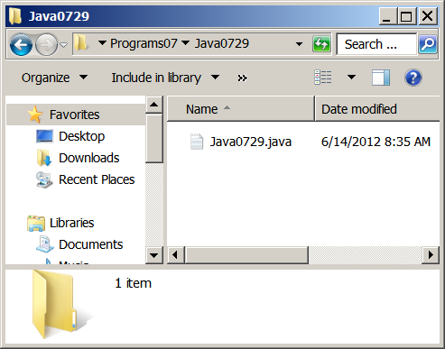
Step 1 Investigate Folder Java0729
NOTE: There is no gridworld.jar file this time.

Slide 76
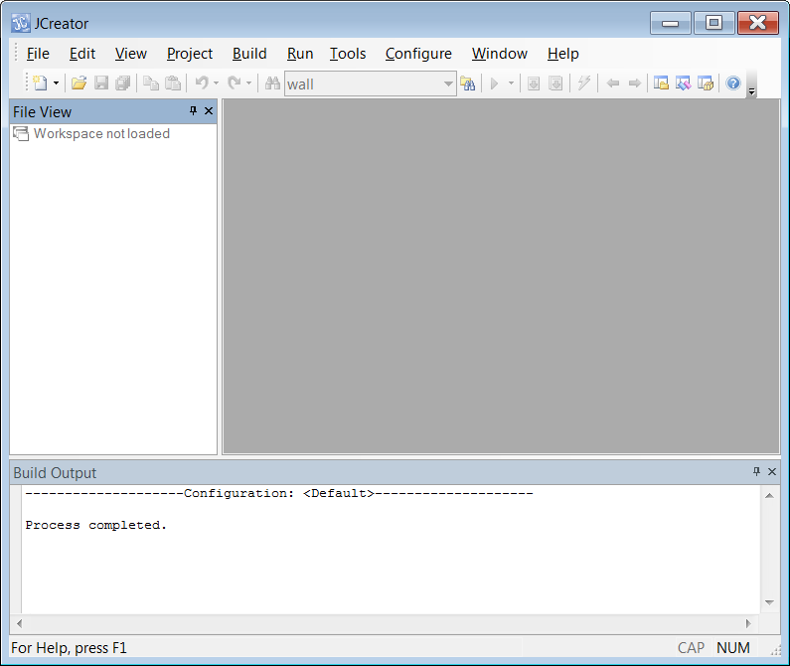
Step 2 Start JCreator
If you do not have the window shown on the left, click View and select File View.

Slide 77
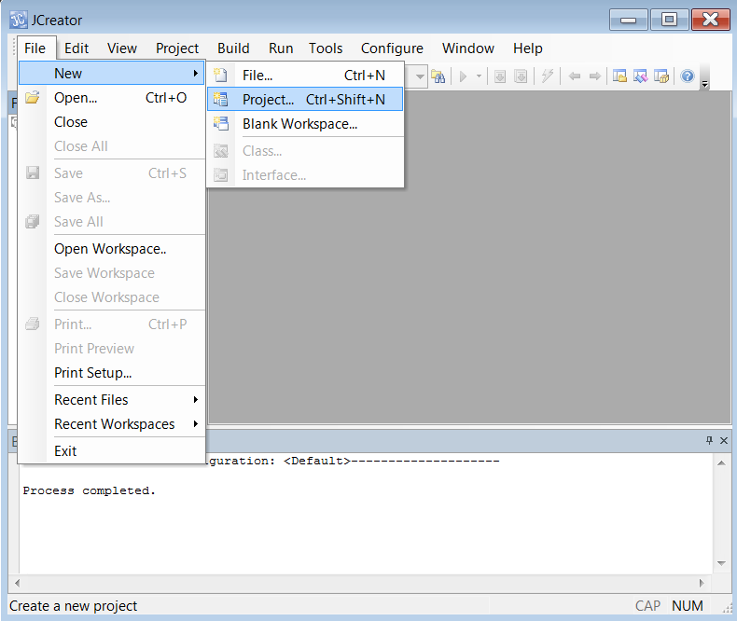
Step 3A Click File – New – Project

Slide 78
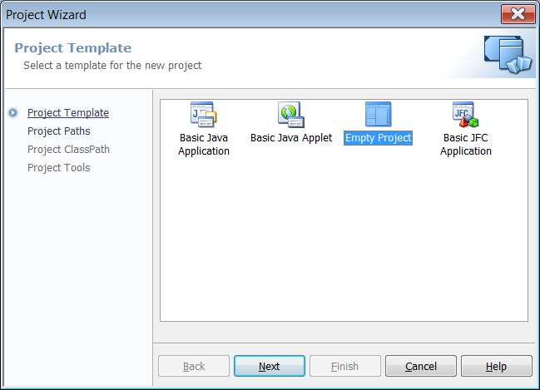
Step 3B Click Empty Project & Next.

Slide 79
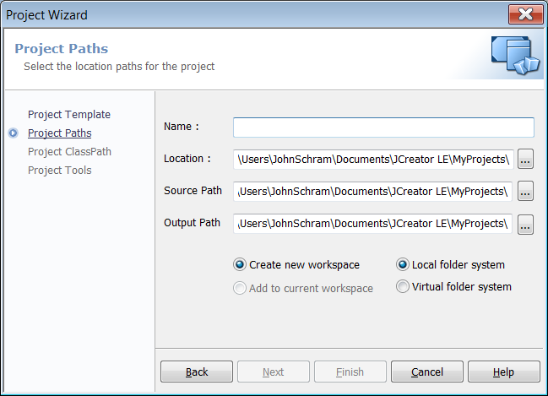
Step 3C Click This Button.

Slide 80
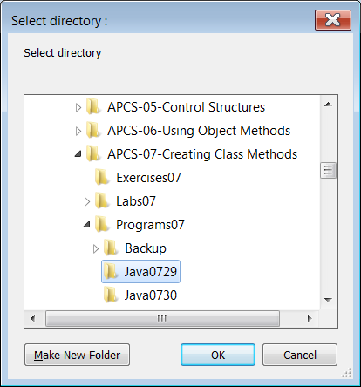
Step 3D Browse to Java0729
and
click
OK.

Slide 81
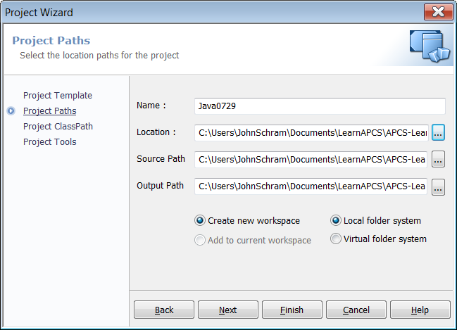
Step 3E DO NOT CLICK FINISH!!!!
Instead click Next.

Slide 82
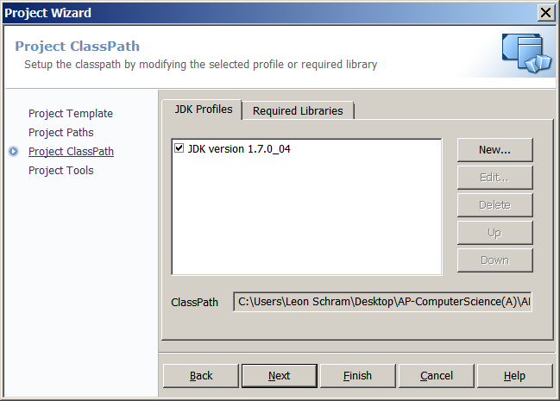
Step 4A Click Required Libraries
Then click New.

Slide 83
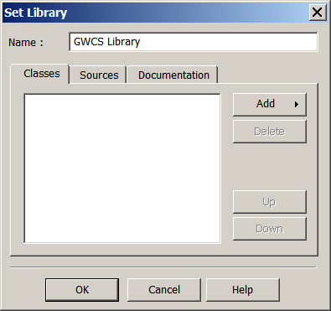
Step 4B – Type GWCS Library for the Name.

Slide 84
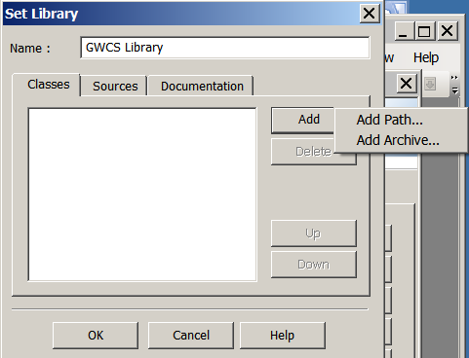
Step 4C Click Add. Click Add Archive.

Slide 85
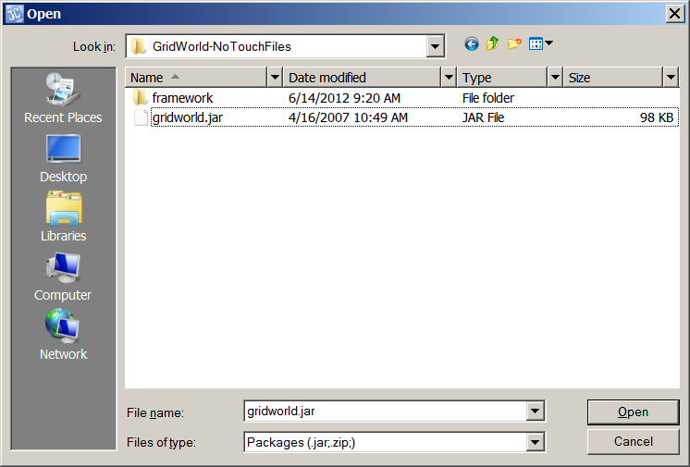
Step 4D – Navigate to GridWorld-NoTouchFiles
Click gridworld.jar
Click Open.
Click OK.

Slide 86
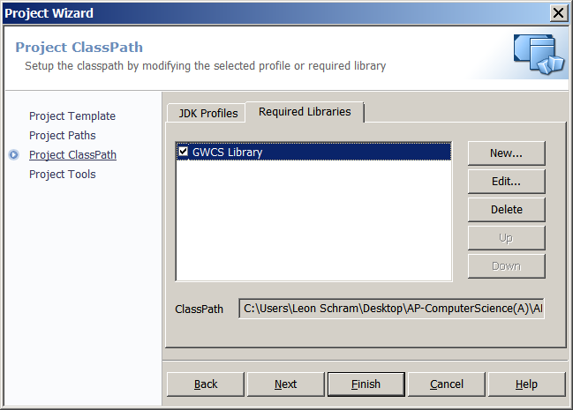
Step 4E Check this checkbox
Click gridworld.jar
Click Open.
Click OK.
Now
Click Finish Twice.

Slide 87
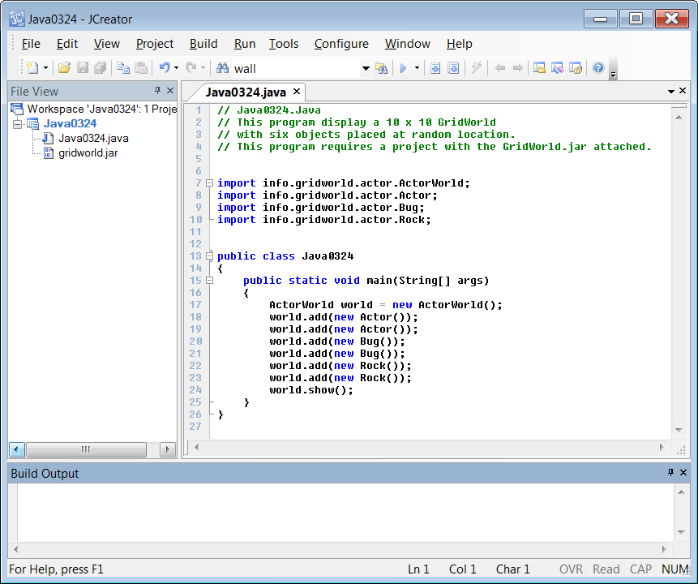
Step 5A Click the Build Project Icon

Slide 88
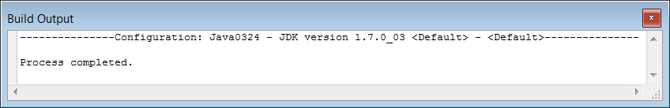
Step 5B If everything was done properly, you will see this in the Build Output window.

Slide 89
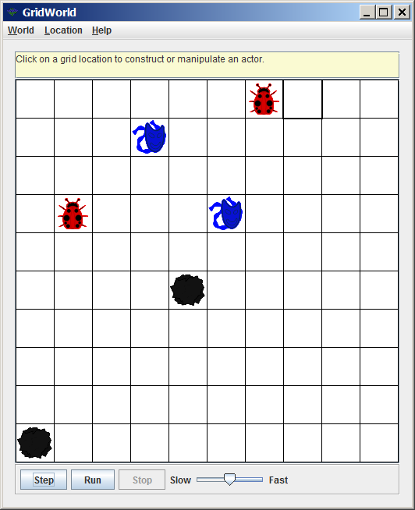
Step 5C Click the Run Project Icon

Slide 90
Section 7.9
Observing the
Bug act Method

Slide 91
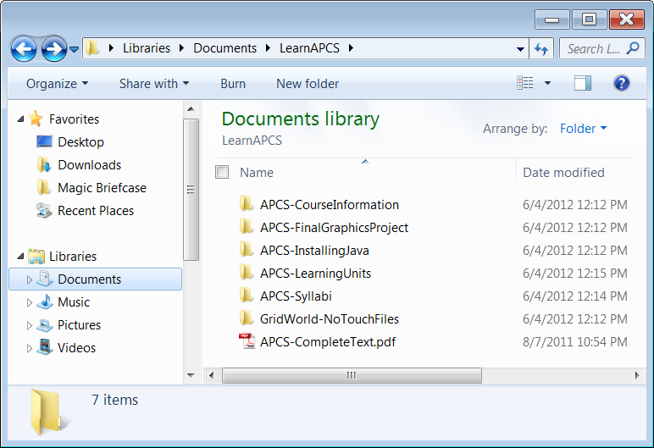
GridWorld Case Study Files - 01

Slide 92
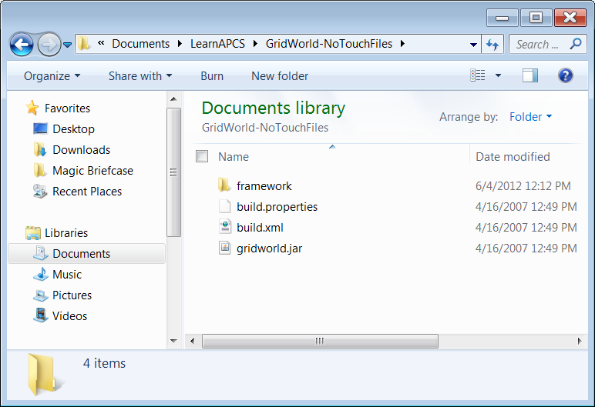
GridWorld Case Study Files - 02

Slide 93
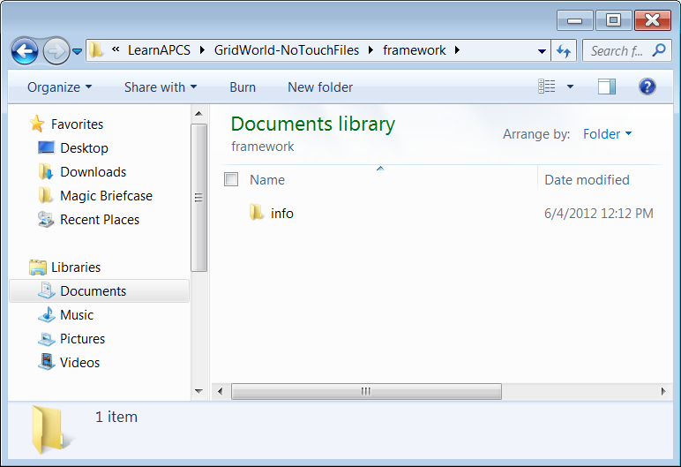
GridWorld Case Study Files - 03

Slide 94
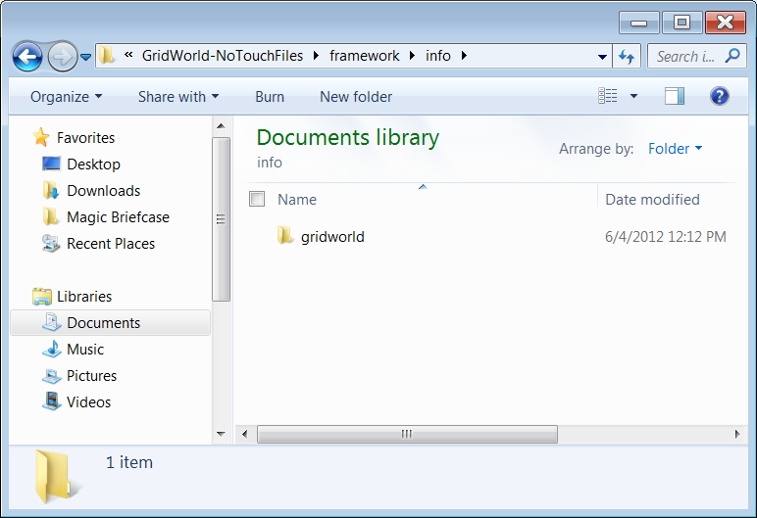
GridWorld Case Study Files - 04

Slide 95
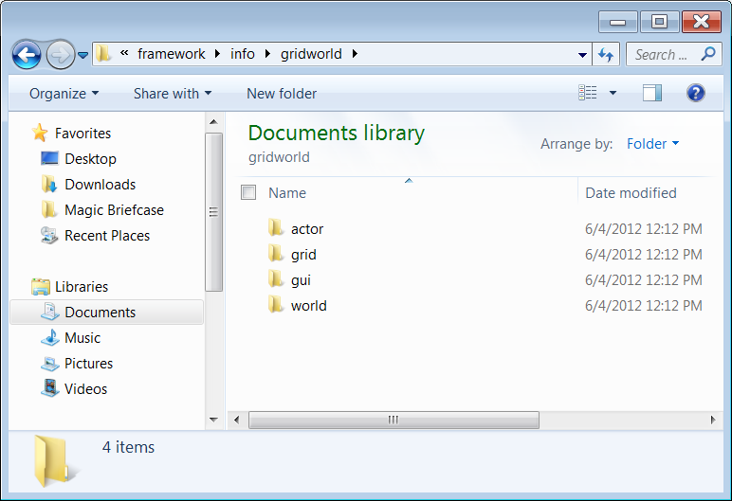
GridWorld Case Study Files - 05

Slide 96
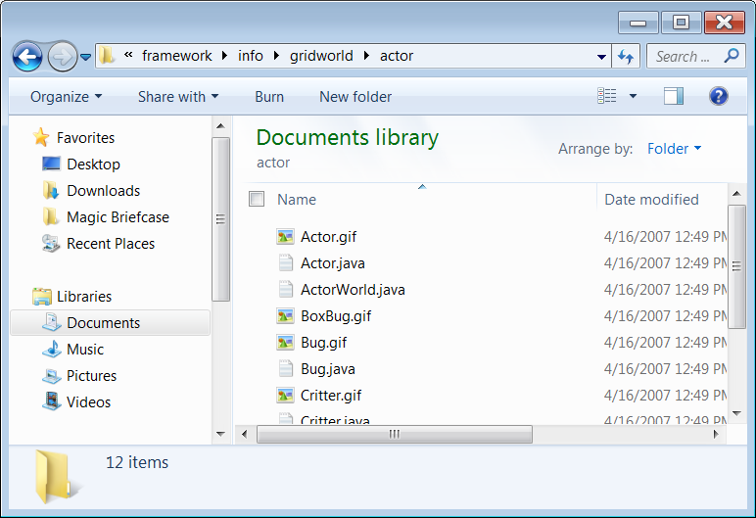
GridWorld Case Study Files - 06

Slide 97
GridWorld Case Study Files - 07

Slide 98
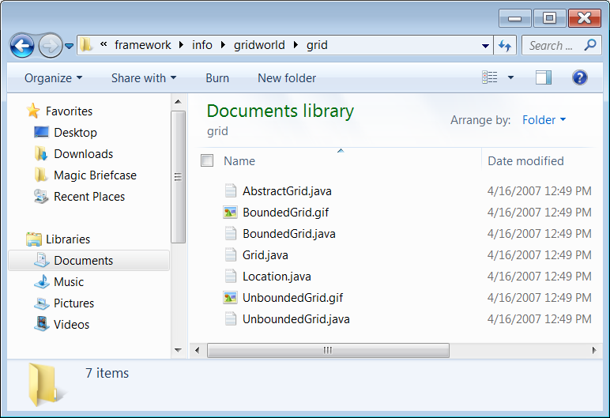
GridWorld Case Study Files - 08

Slide 99
GridWorld Case Study Files - 09

Slide 100
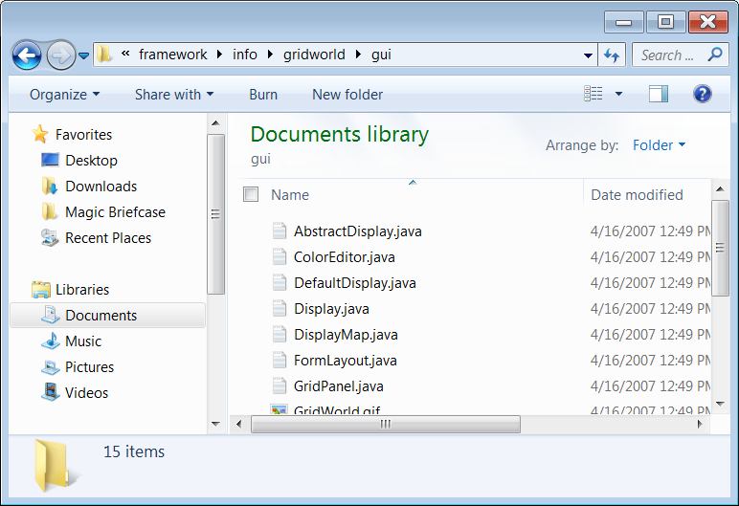
GridWorld Case Study Files - 10

Slide 101
GridWorld Case Study Files - 11

Slide 102
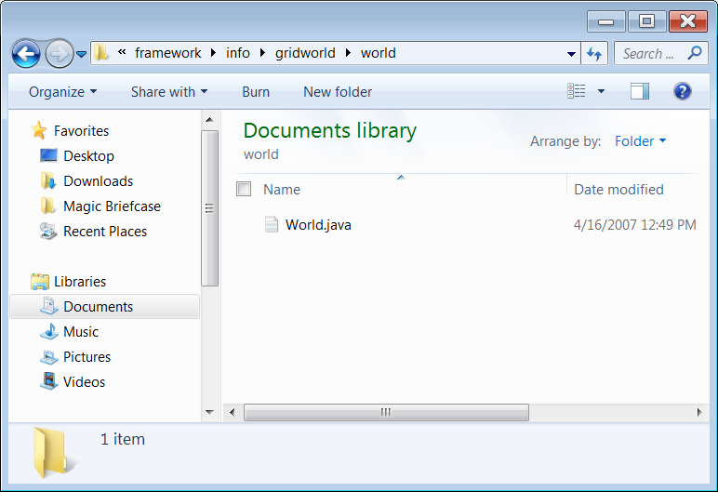
GridWorld Case Study Files - 12

Slide 103
Observe Bug Method act
public void act()
{
if (canMove())
move();
else
turn();
}

Slide 104
Observe Bug Method turn
public void turn()
{
setDirection(getDirection() + Location.HALF_RIGHT);
}

Slide 105
Section 7.10
Creating New
Bug Objects

Slide 106
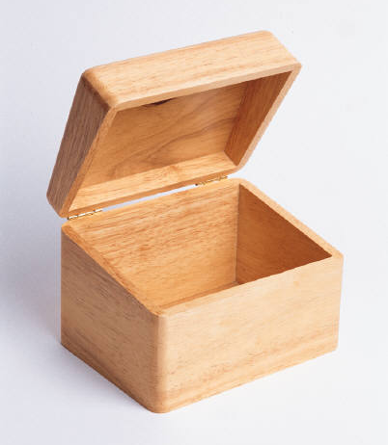
Empty Method Container
public void displaySum(int n1, int n2)
{
}

Slide 107
Method with 1-Line Body
public void displaySum(int n1, int n2)
{
System.out.println(n1 + n2);
}

Slide 108
Lab Experiment 0730 Mission
The mission of this lab experiment is to alter the behavior of the Bug object, such that it will make 90-degree clockwise turns when it cannot move rather than the current 45-degree clockwise turns.

Slide 109
Lab Experiment 0730 Step 1
Create a Project for Lab Experiment Java0730
Remember that you need to attach the library that you created in Java0729.
It is not necessary to create the library again. That is now done permanently.
However, you do need to place a check in front of the library name for each new project

Slide 110
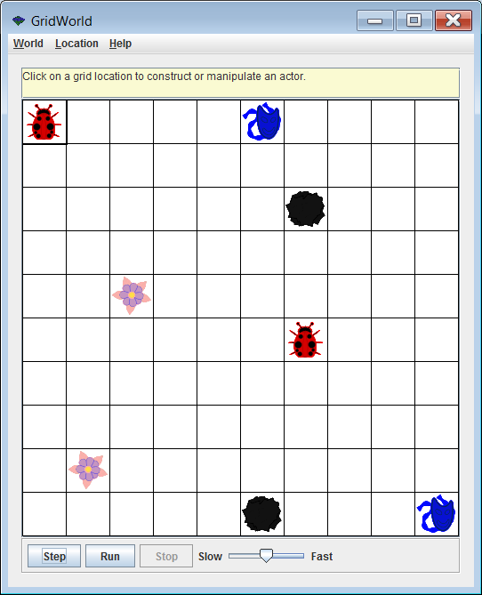
Lab Experiment 0730 Step 2A
Compile and Execute Java0730
The GridWorld execution will be the same for everybody and for each time that you execute the program.
The Bug class is not yet altered to change the behavior of the Bug object.
Click the Run button and observe the behavior of the objects.

Slide 111
Lab Experiment 0730 Step 2B
You will find that every object acts in the manner that you have observed before.
The Rock does nothing.
The Actor flips around doing 180-degree turns.
The Bug moves one cell and drops a flower, if possible, otherwise turns 45-degrees.
The Flower starts out red and slowly turns darker.

Slide 112
Lab Experiment 0730 Step 3A
Change the act method as shown below in the Bug.java file.
public void act()
{
if (canMove())
move();
else
{
turn();
turn();
}
}

Slide 113
Lab Experiment 0730 Step 3B
Re-compile the project.
Execute again and
Click Run.
Is the behavior as expected?

Slide 114
Lab Experiment 0730 CHALLENGE
You now need to make several changes to create a new Bug behavior.
This time the Bug objects needs to make
90-degree left turns.
There are several approaches that will work correctly.
Your solution must include a new method, called leftTurn that turns 90-degrees left.

